Slide 1
Principles of Compiler Construction
Lecture 8 Syntax Analysis (IV)
Lecturer: CHANG HUIYOU
Note that most of these slides were created by:
Prof. Wen-jun LI (School of Software)

Slide 2
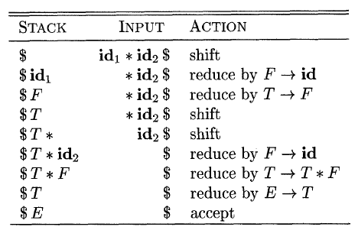
回顾: Shift-Reduce

Slide 3
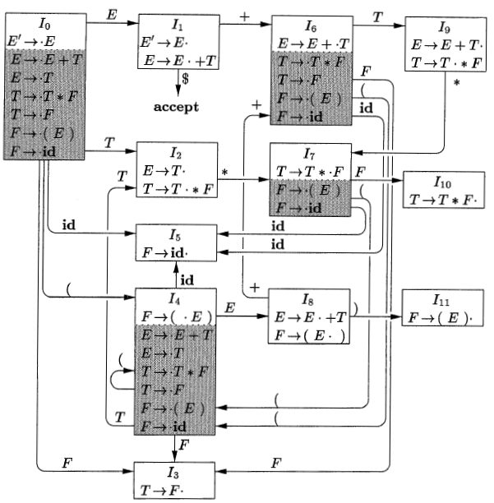
回顾： LR(0)自动机

Slide 4
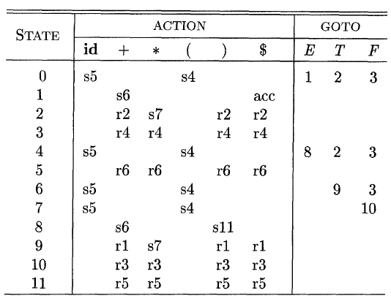


回顾: LR Parsing Table

Slide 5

回顾：非SLR文法
A shift/reduce conflict on input symbol '=', since '=' ∈ FOLLOW(R)
I₀
S' → • S
S → • L = R
S → • R
L → • * R
L → • id
R → • L
I₂
S → L • = R
R → L •
L
...
问题：如何避免这种移进/归约冲突？

Slide 6
思考
凡事预则立，不预则废。
－－《礼记·中庸》
如果不是等到可能要归约的时候才来根据FOLLOW集判断能否归约，而是一开始就做好准备，会不会好一些？

Slide 7
LR(1) Items
[A→α·β, a]
A→αβ is a production
a is a terminal or $
A→α·β is called the core of this item

Slide 8
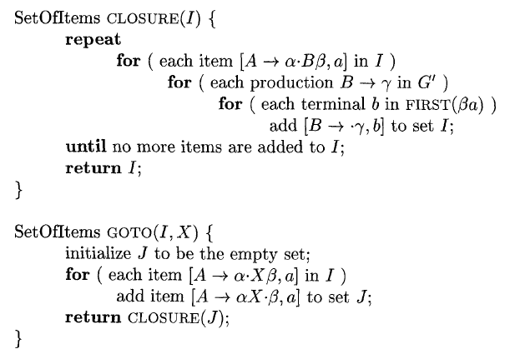
CLOSURE and GOTO

Slide 9
An Example
Consider the following grammar:
(0) S' → S
(1) S → C C
(2) C → c C
C → d
It is easy to calculate the following sets:
FIRST(S) = FIRST(C) = { c, d }

Slide 10
I₁
I₅
I₇
S' → S •, $
S → C C •, $
C → d •, $
S
C
d
d
c
I₀
I₂
I₆
I₉
S' → • S, $
S → • C C, $
C → • c C, c/d
C → • d, c/d
S → C • C, $
C → • c C, $
C → • d, $
C → c • C, $
C → • c C, $
C → • d, $
C → c C •, $
C
c
C
d
c
c
I₈
I₄
I₃
C → d •, c/d
C → c • C, c/d
C → • c C, c/d
C → • d, c/d
C → c C •, c/d
d
C
DFA recognizing all viable prefixes

Slide 11
LR(1) Parsing Table
State | ACTION |  |  | GOTO
 | c | d | $ | S | C
0 | s3 | s4 |  | 1 | 2
1 |  |  | acc
2 | s6 | s7 |  |  | 5
3 | s3 | s4 |  |  | 8
4 | r3 | r3
5 |  |  | r1
6 | s6 | s7 |  |  | 9
7 |  |  | r3
8 | r2 | r2
9 |  |  | r2

Slide 12
LR(1) Grammar
The table produced by this algorithm is called the canonical LR(1) parsing table.
An LR parser using this table is called a canonical-LR(1) parser.
If the parsing action function has no multiply defined entries, then the given grammar is called an LR(1) grammar.

Slide 13
Disadvantage of LR(1) Parsing
Too many states!
Number of states, such as C or Pascal
LR(0) = SLR(1): several hundreds.
LR(1): several thousands (10 times).

Slide 14
LALR (Lookahead LR) Parsing
Often used in practice
LALR tables are considerably smaller than the canonical LR tables
Most common syntactic constructs of programming languages can be expressed conveniently by an LALR grammar

Slide 15
思考
I₁
I₅
I₇
S' → S •, $
S → C C •, $
C → d •, $
S
C
d
d
c
I₀
I₂
I₆
I₉
S' → • S, $
S → • C C, $
C → • c C, c/d
C → • d, c/d
S → C • C, $
C → • c C, $
C → • d, $
C → c • C, $
C → • c C, $
C → • d, $
C → c C •, $
C
c
C
d
c
c
I₈
差别不大，能否合并？
I₄
I₃
C → d •, c/d
C → c • C, c/d
C → • c C, c/d
C → • d, c/d
C → c C •, c/d
d
C

Slide 16
LALR Parsing
Strategy for LALR(1): merge the states with the same core.
E.g. I₃ and I₆, I₄ and I₇, I₈ and I₉
Lookaheads of the same item are merged.
GOTO() depends only on the core.

Slide 17
LALR vs. LR(1)
The merge will never produce new shift-reduce conflicts
Suppose in the merged state
[A → α •, a] calls for a reduction
[B → β • a γ, b] calls for a shift
Since the original states have the same core, there must be some state have
[A → α •, a] calls for a reduction
[B → β • a γ, c] calls for a shift (for some c)
Then the original state already has conflicts.

Slide 18
LALR vs. LR(1) (cont')
But the merge will produce new reduce-reduce conflicts
For example
S' → S
S → a A d | b B d | a B e | b A e
A → c
B → c
{[A → c •, d], [B → c •, e]} is valid for viable prefix ac, {[A → c •, e], [B → c •, d]} is valid for viable prefix bc. But the merge has conflicts:
{[A → c •, d/e], [B → c •, d/e]}

Slide 19
Example: New Conflicts in LALR
I₁
I₂
S → a • A d, $
S → a • B e, $
A → • c, d
B → • c, e
A → c •, d
B → c •, e
I₀
c
a
S' → • S, $
S → • a A d, $
S → • b B d, $
S → • a B e, $
S → • b A e, $
I₃
I₄
S → b • B d, $
S → b • A e, $
A → • c, e
B → • c, d
A → c •, e
B → c •, d
b
c
Part of the DFA recognizing all viable prefixes

Slide 20
Ambiguous Expression Grammar
Given the ambiguous grammar
(0) E' → E
(1) E → E + E
(2) E → E * E
(3) E → ( E )
(4) E → id

Slide 21
I₃
I₂
(
I₆
I₉
E → id •
E → ( • E )
E → • E + E
E → • E * E
E → • ( E )
E → • id
E → ( E • )
E → E • + E
E → E • * E
E → ( E ) •
id
E
)
id
*
+
I₀
I₅
(
I₈
(
id
E' → • E
E → • E + E
E → • E * E
E → • ( E )
E → • id
E → E * • E
E → • E + E
E → • E * E
E → • ( E )
E → • id
E → E * E •
E → E • + E
E → E • * E
E
*
+
I₁
E
I₄
(
I₇
*
E' → E •
E → E • + E
E → E • * E
id
E → E + • E
E → • E + E
E → • E * E
E → • ( E )
E → • id
E → E + E •
E → E • + E
E → E • * E
*
+
E
+
DFA recognizing all viable prefixes
shift-reduce conflict

Slide 22
SLR(1) Parsing Table
State | ACTION |  |  |  |  |  | GOTO
 | id | + | * | ( | ) | $ | E
0 | s3 |  |  | s2 |  |  | 1
1 |  | s4 | s5 |  |  | acc
2 | s3 |  |  | s2 |  |  | 6
3 |  | r4 | r4 |  | r4 | r4
4 | s3 |  |  | s2 |  |  | 7
5 | s3 |  |  | s2 |  |  | 8
6 |  | s4 | s5 |  | s9
7 |  | r1/s4 | r1/s5 |  | r1 | r1
8 |  | r2/s4 | r2/s5 |  | r2 | r2
9 |  | r3 | r3 |  | r3 | r3
Resolve ambiguities
at the parsing table level

Slide 23
Dangling-else Grammar
Given the ambiguous grammar
(0) S' → S
(1) S → i S e S
(2) S → i S
(3) S → a

Slide 24
DFA Recognizing All Viable Prefixes
I₁
S' → S •
i
I₀
S
I₂
I₄
I₅
i
S' → • S
S → • i S e S
S → • i S
S → • a
S → i • S e S
S → i • S
S → • i S e S
S → • i S
S → • a
S → i S • e S
S → i S •
S → i S e • S
S → • i S e S
S → • i S
S → • a
i
S
e
a
a
I₃
a
I₆
S
S → a •
S → i S e S •
shift-reduce conflict

Slide 25
SLR(1) Parsing Table
State | ACTION |  |  |  | GOTO
 | i | e | a | $ | S
0 | s2 |  | s3 |  | 1
1 |  |  |  | acc
2 | s2 |  | s3 |  | 4
3 |  | r3 |  | r3
4 |  | r2/s5 |  | r2
5 | s2 |  | s3 |  | 6
6 |  | r1 |  | r1
Resolve ambiguities
at the parsing table level

Slide 26
Parsing a Sentence
Step | Symbol | State | Input | Reference | Action | Output
1 | $ | 0 | i i a e a $ | a[0, i] = s2 | shift
2 | $ i | 0 2 | i a e a $ | a[2, i] = s2 | shift
3 | $ i i | 0 2 2 | a e a $ | a[2, a] = s3 | shift
4 | $ i i a | 0 2 2 3 | e a $ | a[3, e] = r3 g[2, S] = 4 | reduce | S → a
5 | $ i i S | 0 2 2 4 | e a $ | a[4, e] = s5 | shift
6 | $ i i S e | 0 2 2 4 5 | a $ | a[5, a] = s3 | shift
7 | $ i i S e a | 0 2 2 4 5 3 | $ | a[3, $] = r3 g[5, S] = 6 | reduce | S → a
8 | $ i i S e S | 0 2 2 4 5 6 | $ | a[6, $] = r1 g[2, S] = 4 | reduce | S → i S e S
9 | $ i S | 0 2 4 | $ | a[4, $] = r2 g[0, S] = 1 | reduce | S → i S
10 | $ S | 0 1 | $ | a[1, $] = acc | accept

Slide 27
Error Recovery
Panic-mode error recovery
Phrase-level recovery
Error-Productions
Global-Correction

Slide 28
Example
I₃
I₂
(
I₆
I₉
E → id •
E → ( • E )
E → • E + E
E → • E * E
E → • ( E )
E → • id
E → ( E • )
E → E • + E
E → E • * E
E → ( E ) •
id
E
)
id
*
+
I₀
I₅
(
I₈
(
id
E' → • E
E → • E + E
E → • E * E
E → • ( E )
E → • id
E → E * • E
E → • E + E
E → • E * E
E → • ( E )
E → • id
E → E * E •
E → E • + E
E → E • * E
E
*
+
I₁
E
I₄
(
I₇
*
E' → E •
E → E • + E
E → E • * E
id
E → E + • E
E → • E + E
E → • E * E
E → • ( E )
E → • id
E → E + E •
E → E • + E
E → E • * E
*
+
E
+

Slide 29
Example
State | ACTION |  |  |  |  |  | GOTO
 | id | + | * | ( | ) | $ | E
0 | s3 | e1 | e1 | s2 | e2 | e1 | 1
1 | e3 | s4 | s5 | e3 | e2 | acc
2 | s3 | e1 | e1 | s2 | e2 | e1 | 6
3 | r4 | r4 | r4 | r4 | r4 | r4
4 | s3 | e1 | e1 | s2 | e2 | e1 | 7
5 | s3 | e1 | e1 | s2 | e2 | e1 | 8
6 | e3 | s4 | s5 | e3 | s9 | e4
7 | r1 | r1 | s5 | r1 | r1 | r1
8 | r2 | r2 | r2 | r2 | r2 | r2
9 | r3 | r3 | r3 | r3 | r3 | r3
Postpone error detection until one or more reductions are made

Slide 30
Error-Handling Routines
e1: an operand 'id' or '(' is expected.
push state 3; // add a symbol 'id'
e2: unbalanced right parenthesis.
drop one lookahead; // remove ')'
e3: an operator is expected.
push state 4; // add a symbol '+'
e4: a right parenthesis is expected.
push state 9; // add a symbol ')'

Slide 31
Parsing an Erroneous Input
Step | Symbol | State | Input | Reference | Action | Output
1 | $ | 0 | id + ) $ | a[0, id] = s3 | shift
2 | $ id | 0 3 | + ) $ | a[3, +] = r4 g[0, E] = 1 | reduce | E → id
3 | $ E | 0 1 | + ) $ | a[1, +] = s4 | shift
4 | $ E + | 0 1 4 | ) $ | a[4, )] = e2 | drop | Unbalanced ')'
5 | $ E + | 0 1 4 | $ | a[4, $] = e1 | push 3 | Operand expected
6 | $ E + id | 0 1 4 3 | $ | a[3, $] = r4 g[4, E] = 7 | reduce | E → id
7 | $ E + E | 0 1 4 7 | $ | a[7, $] = r1 g[0, E] = 1 | reduce | E → E + E
8 | $ E | 0 1 | $ | a[1, $] = acc | end

Slide 32
See you next time!

